Slide 1
Selenium Basic for Student
Sarower Ahmmed

Slide 2
Automation Tools or API
QTP=tool
Selenium=API

Slide 3
Selenium | QTP/UFT
Open source/free | Vender tool / costly
Web application | Web and client application
Cross browser & parallel- better | Can do but not like Selenium
Supports various operating systems | Windows only
Can execute tests in parallel. | Can only execute in parallel with version 12.5 UFT
JAVA, PYTHON, RUBY…………. | Vbscript
No Object Repo, but can create | Have Object Repo
As open source ,some security issue | More secured
NO support | HP support

Slide 4
Selenium word
A Chemical element of atomic number 34.
The name Selenium comes from a joke made by Huggins in an email,
“mocking a competitor named Mercury, saying that you can cure mercury poisoning by taking selenium supplements”.

Slide 5
WHY??
Selenium provides a web based automation api.
It is open-source software and can be downloaded and used without any cost.

Slide 6
Programming Languages & Frameworks
No need to learning a test scripting language.
Provides a test domain-specific language (Selenese).
Language support by Selenium including
C#, Groovy, Java, Perl, PHP, Python, Ruby and Scala.
No C or C++

Slide 7
Platforms Supported by Selenium
Browsers:
Firefox
Internet Explorer
Safari Driver
Opera
Chrome
Operating Systems:
Microsoft Windows
Apple OS X
Linux

Slide 8
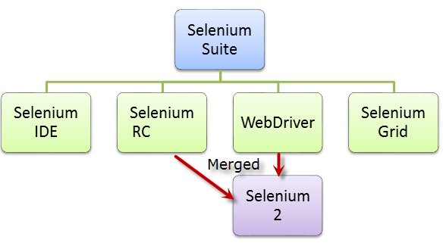
Selenium components

Slide 9
Eclipse
It’s a compiler for Java selenium
Its called IDE

Slide 10

History
Selenium was originally developed by Jason Huggins in 2004: as an internal tool at ThoughtWorks

Slide 11

Paul Hammant joined the team and development of the second mode of operation that would later become 'Selenium Remote Control' (RC)

Slide 12
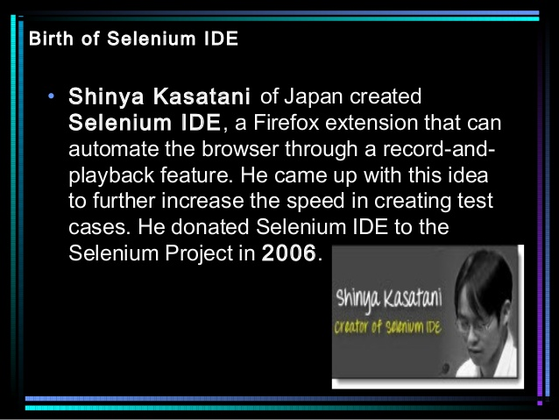
History

Slide 13
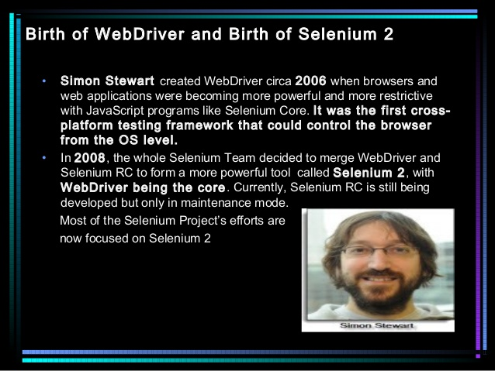
In 2007, Huggins joined Google.
Simon Stewart at ThoughtWorks developed a superior browser automation tool called WebDriver.

Slide 14
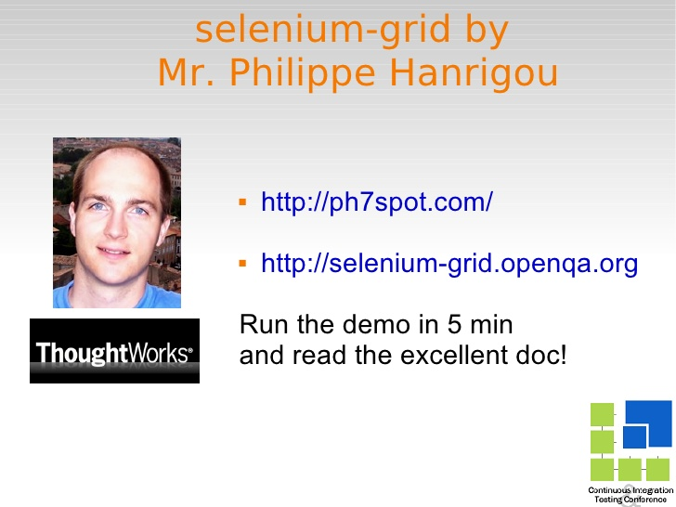
In 2008, Philippe Hanrigou (then at ThoughtWorks) made 'Selenium Grid'

Slide 15
In 2009, at the Google Test Automation Conference,
it was decided to merge the RC & webdriver, and call the new project –
Selenium WebDriver, or Selenium 2.0.

Slide 16
SELNIUM
Selenium is a API
Whats API????
Application programming interface……means???
A language and message format used by an application program to communicate with the operating system or some other control program such as a database management system (DBMS) or communications protocol.

Slide 17
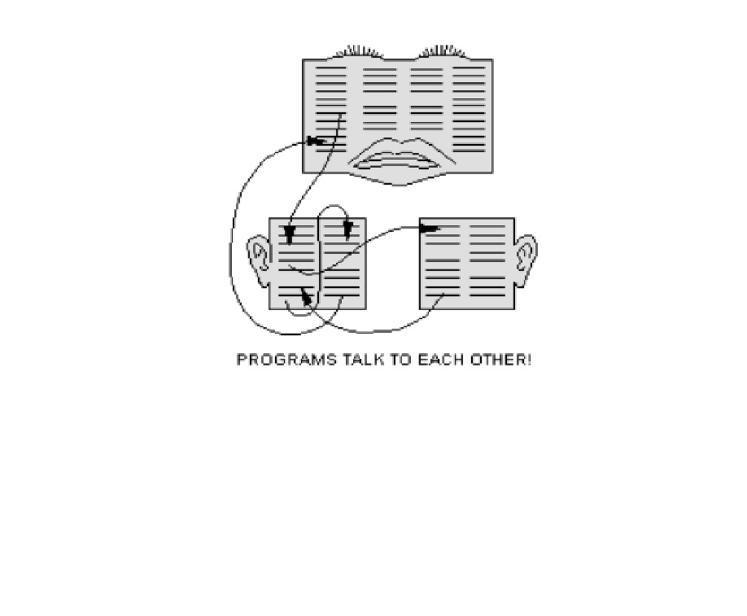
an application program to communicate with the operating system or some other control program

Slide 18
Selenium components

Slide 19
Selenium IDE
Selenium IDE is a complete integrated development environment (IDE)
It is implemented as a Firefox Add-On, and Allows
recording,
editing, and
debugging tests.
It was previously known as Selenium Recorder

Slide 20
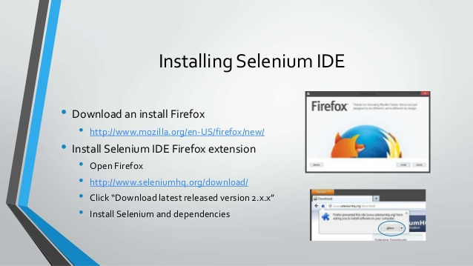

Slide 21


Slide 22
Selenium Web Driver, or Selenium 2.0.
Work with any modern browser.
Used browser native command-HTML
Selenium 1 only used Java command

Slide 23
Setup for web driver
Delete old version of Java JDK and JRE
Install new version of Java
Install Eclipse and copy to C drive
Open eclipse>>new java project>>new class name
Then method name: Void and public

Slide 24
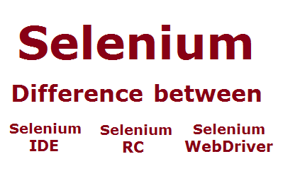

Slide 25
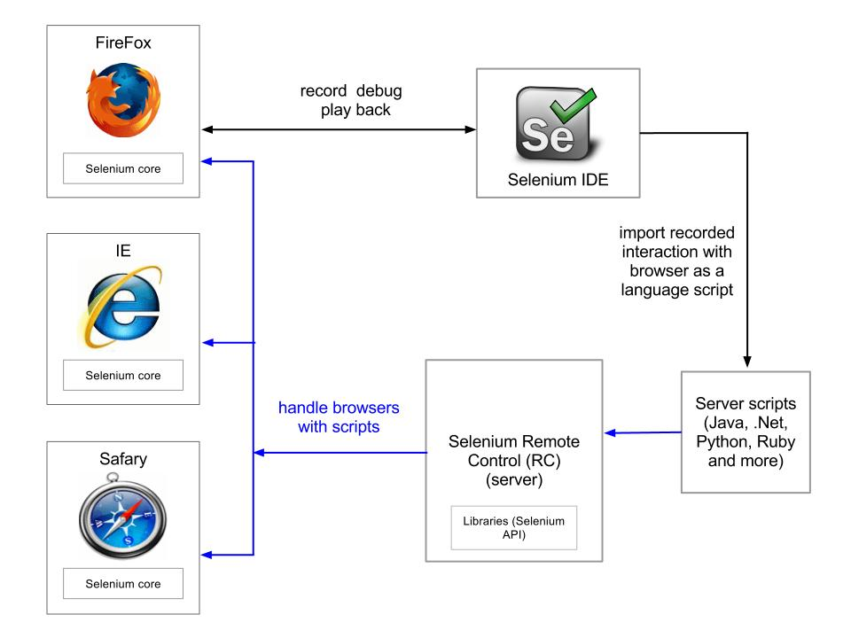

Slide 26
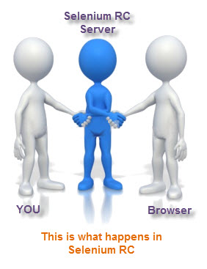
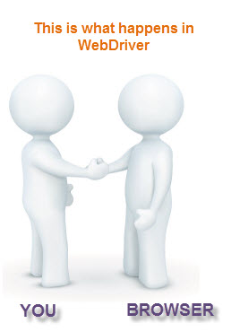
Real-life Interaction

Slide 27
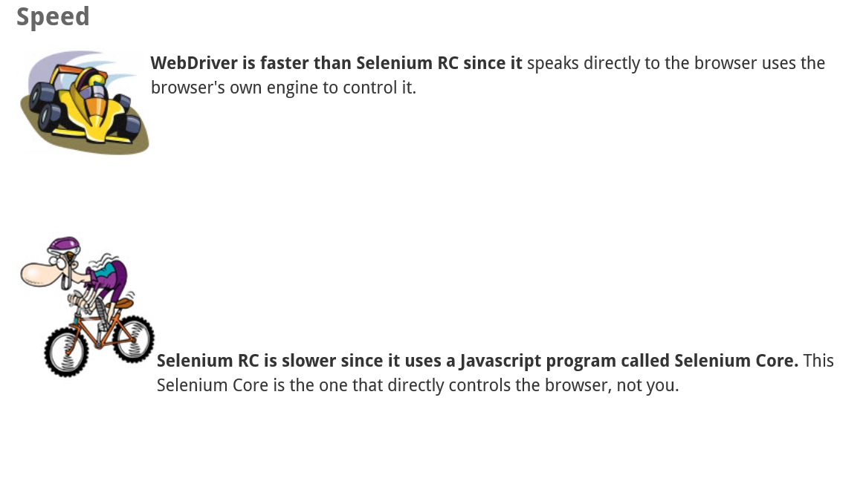

Slide 28
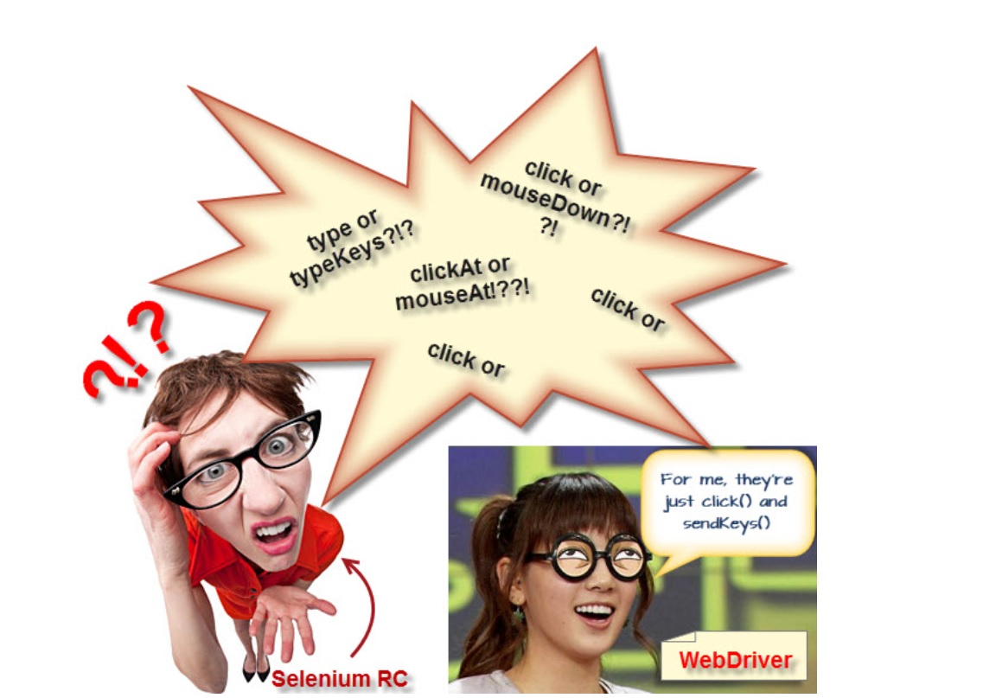
Application programming interface

Slide 29
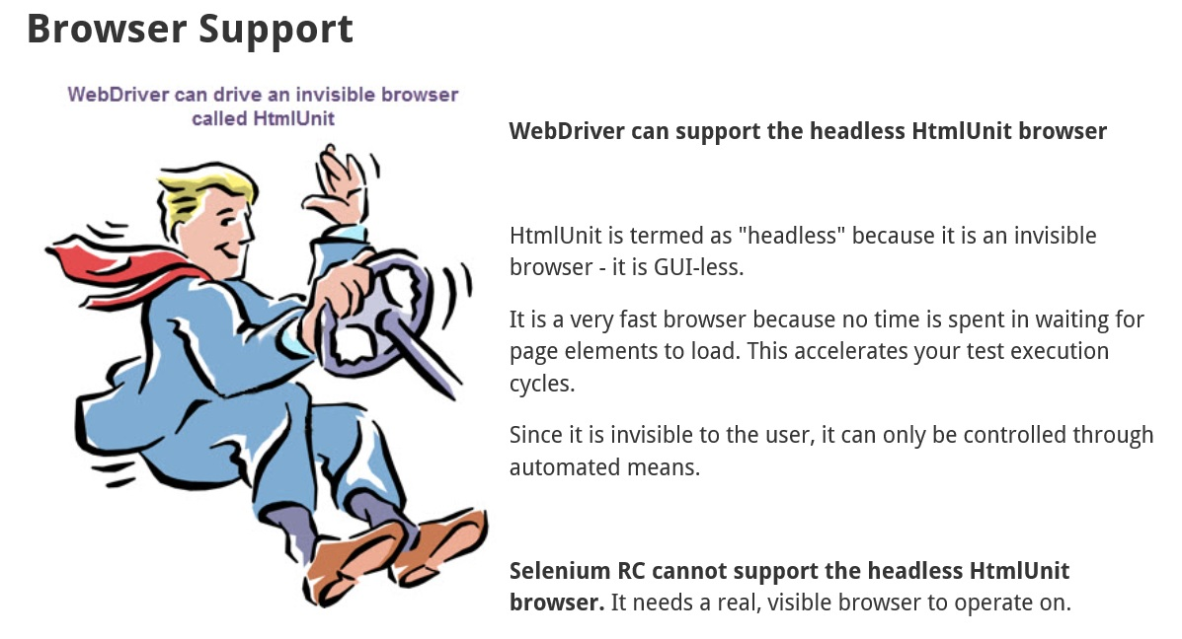

Slide 30
Points | Selenium IDE | Selenium RC | Web driver
Browser | Only Mozilla | All browser, but not works with latest Firefox/IE | All latest browser
Tool | Record and run | No record & run | No record & run
Server | No need | Need | No need
Core engine | Java script based | Java script based | Browser native command
Application programming interface | Very simple | Simple API ,but confusing commands | Large & complex ,but clear & no confusion
‘xpath=//’syntax | Full path have to be appended | Full path have to be appended | No need
Mouse movement | Can not | Can not | Can
Event Listeners | No | No | Implemented
Iphone/ Android application | Can’t test | Can’t test | Can test
Test Results File | Need pluggin | Build in | Not

Slide 31

Drawbacks of Selenium
Open Source API- Security issue
No good help desk from Apache but good support community
No Report
Need Knowledge of any programing
language with selenium command
Cant Automate where no HTML
Such as Flex application

Slide 32
Testing(SOAP & REST) | Testing(SOAP & REST) | Testing(SOAP & REST)
Testing(SOAP & REST) | Testing(SOAP & REST) | Testing(SOAP & REST)
Jenkins | Git/SVN/TFS | Cucumber/Specflow | SOAP UI/Eclipse JAVA | Jmeter/ LoadRunner
CI + CS | Version control | BDD/ATDD | Web service Testing(SOAP & REST) | Performance + API testing

